Slide 1

Note: The data and information in this document is reflective of a hypothetical situation and client. This document is to be used for KPMG Virtual Internship purposes only.
Sprocket Central Pty Ltd
Data analytics approach
[Division Name] - [Engagement Manager], [Senior Consultant], [Junior Consultant]

Slide 2
Note: The data and information in this document is reflective of a hypothetical situation and client. This document is to be used for KPMG Virtual Internship purposes only.
Agenda
Introduction
Data Exploration
Model Development
Interpretation

Slide 3
Note: The data and information in this document is reflective of a hypothetical situation and client. This document is to be used for KPMG Virtual Internship purposes only.
Introduction
Identifying the top 1000 Sprocket Central Pty Ltd to target using the provided three datasets.
Problem statement:
Using the existing 3 datasets (Customer demographic, customer address and transactions) as a labelled dataset, please recommend which of these 1000 new customers should be targeted to drive the most value for the organization.
Data analysis contents:
Old and new customers age distribution
Customers job industry distribution
Age vs wealth segmentation
No .of cars owned in a state

Slide 4
Note: The data and information in this document is reflective of a hypothetical situation and client. This document is to be used for KPMG Virtual Internship purposes only.
Data Exploration
Old and new customers age distribution.
From the graphs we can infer that most number of the customers are from age group 40 to 49 in both old and new customers.
In old customers less no of customers are from age group 80 to 89 while in new customers less no of customers are from age group 10 to 19.

Slide 5
Note: The data and information in this document is reflective of a hypothetical situation and client. This document is to be used for KPMG Virtual Internship purposes only.
Data Exploration
Old and new customers job industry distribution.
From both old and new customers 24% of the total customers are from manufacturing and 18% from health sector.
In new customers smallest no of customers are from agriculture and finance sector
In old customers less no of customers are from agriculture

Slide 6
Note: The data and information in this document is reflective of a hypothetical situation and client. This document is to be used for KPMG Virtual Internship purposes only.
Data Exploration
Age versus wealth segment distribution.
In both old and new customers the mass customers are more compared to high net worth and affluent customers
In both old and new customers the affluent and the net worth customers are almost same

Slide 7
Note: The data and information in this document is reflective of a hypothetical situation and client. This document is to be used for KPMG Virtual Internship purposes only.
Data Exploration
No . of cars owned in a state.
From the graph we can say that more number of cars are owned in the New south wales
And the less number of cars are owned in the
queensland

Slide 8
Note: The data and information in this document is reflective of a hypothetical situation and client. This document is to be used for KPMG Virtual Internship purposes only.
Model Development
RFM analysis and customer classification.
The RFM analysis is used to determine the which customers to target to increase the revenue
RFM(Recency ,Frequency , Monetary) models shows the customers who have displayed the high engagement in above three values
We will calculate the r_score ,f_score, m_score and then RFM value based on which we segment the customers

Slide 9
Note: The data and information in this document is reflective of a hypothetical situation and client. This document is to be used for KPMG Virtual Internship purposes only.
Model Development
Scatterplot based off RFM analysis.
From the graph we can say customers who are recent generated more revenue
Customers whose recency from 50 to 100 also generated modern revenue
Customers who attended more two hundred days ago generated a low revenue

Slide 10
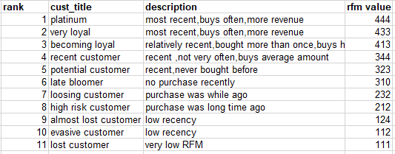
Note: The data and information in this document is reflective of a hypothetical situation and client. This document is to be used for KPMG Virtual Internship purposes only.
Model Development
Customer title definition with RFM values using RFM analysis.

Slide 11
Note: The data and information in this document is reflective of a hypothetical situation and client. This document is to be used for KPMG Virtual Internship purposes only.
Model Development
Customer title distribution in dataset.

Slide 12
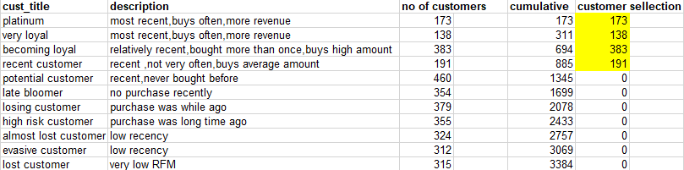
Note: The data and information in this document is reflective of a hypothetical situation and client. This document is to be used for KPMG Virtual Internship purposes only.
Interpretation
Top 1000 customers to target.

Slide 13

Note: The data and information in this document is reflective of a hypothetical situation and client. This document is to be used for KPMG Virtual Internship purposes only.
Interpretation
Top 1000 customers.
The customers discovered in the above table would have bought very recently , very frequently and would have make high revenue.

Slide 14
Note: The data and information in this document is reflective of a hypothetical situation and client. This document is to be used for KPMG Virtual Internship purposes only.
Appendix

Slide 15
Note: The data and information in this document is reflective of a hypothetical situation and client. This document is to be used for KPMG Virtual Internship purposes only.
Appendix
This is an optional slide where you may place any supporting items.

